Slide 1
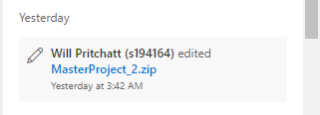
The project was still downloaded by other during the week but all final versions where uploaded by Will shortly after the meeting. Look at external communications to see who downloaded the project and when.

